Slide 1
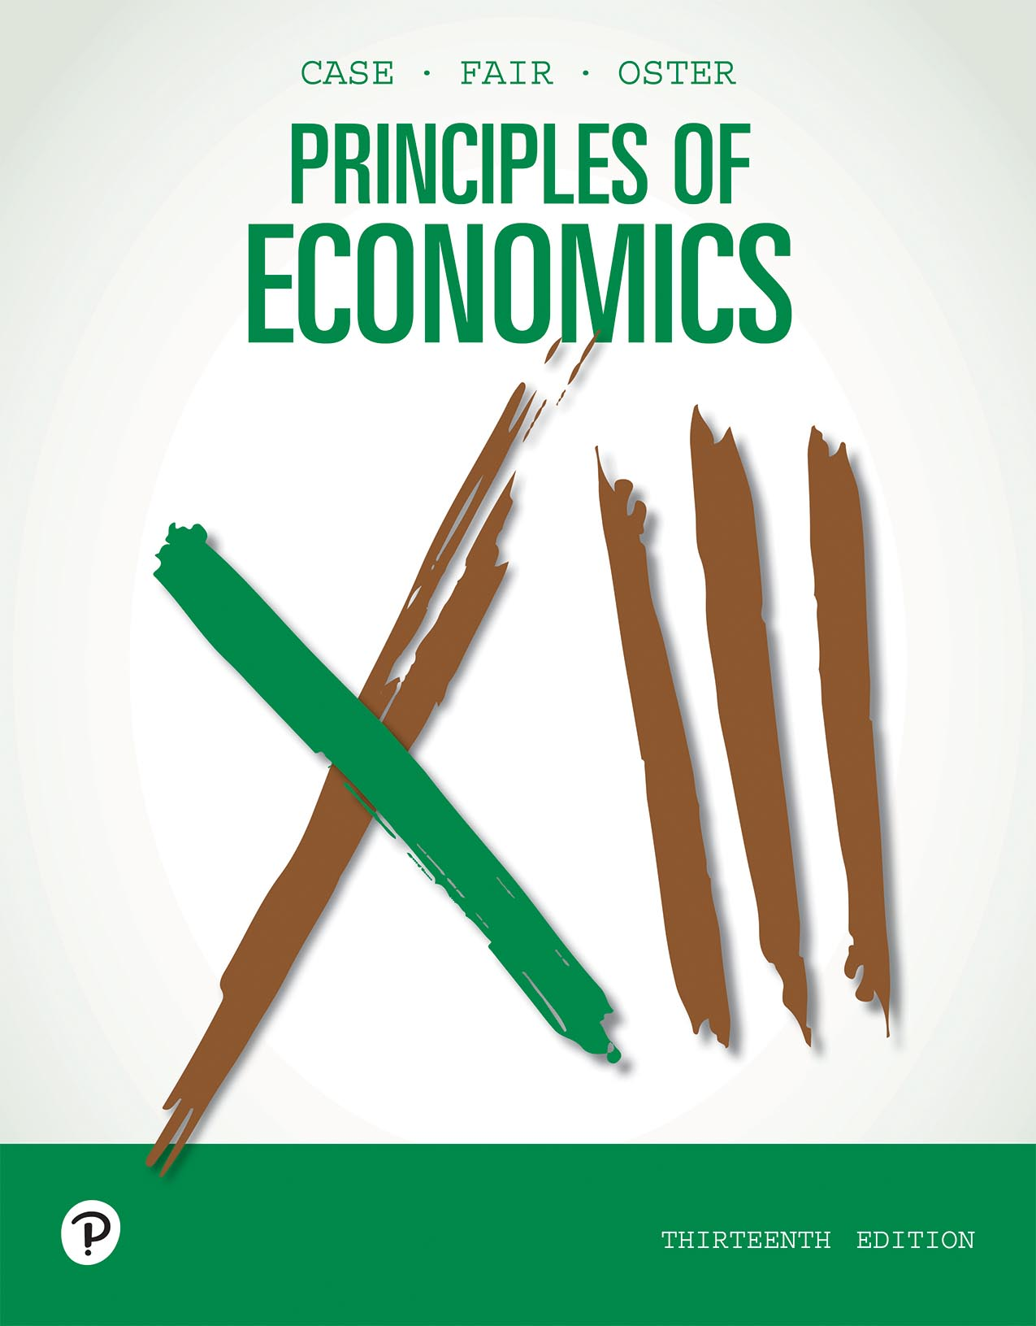
Principles of Economics
Thirteenth Edition
Chapter 14
Oligopoly
Copyright © 2020, 2016, 2011 Pearson Education, Inc. All Rights Reserved
Notes:
If this PowerPoint presentation contains mathematical equations, you may need to check that your computer has the following installed:
1) MathType Plugin
2) Math Player (free versions available)
3) NVDA Reader (free versions available)

Slide 2
Chapter Outline and Learning Objectives (1 of 2)
14.1 Market Structure in an Oligopoly
Describe the structure and characteristics of oligopolistic industries
14.2 Oligopoly Models
Compare and contrast three oligopoly models.
14.3 Game Theory
Explain the principles and strategies of game theory.

Slide 3
Chapter Outline and Learning Objectives (2 of 2)
14.4 Oligopoly and Economic Performance
Discuss the economic performance of oligopolies.
14.5 The Role of Government
Discuss the role of government in oligopolistic industries.

Slide 4
Chapter 14 Oligopoly
Most industries in the United States fall somewhere between the two “pure” market structures: perfect competition and pure monopoly.
oligopoly A form of industry (market) structure characterized by a few dominant firms. Products may be homogenous or differentiated.
Oligopolists compete with one another not only in price but also in developing new products, marketing and advertising those products, and developing complements to use with the products.

Slide 5
Market Structure in an Oligopoly (1 of 2)
Five Forces model A model developed by Michael Porter that helps us understand the five competitive forces that determine the level of competition and profitability in an industry.

Slide 6
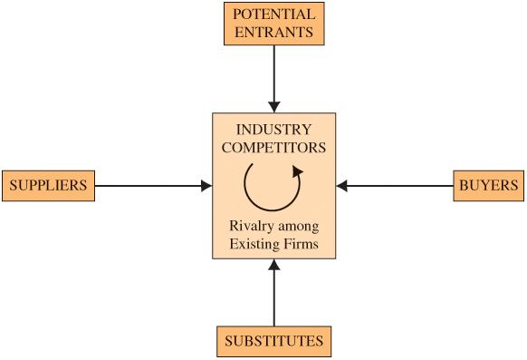
Figure 14.1 Forces Driving Industry Competition

Slide 7
Table 14.1 Percentage of Value of Shipments Accounted for by the Largest Firms in High-Concentration Industries, 2002
Industry Designation | Four Largest Firms | Eight Largest Firms | Number of Firms
Primary copper | 99 | 100 | 10
Cigarettes | 95 | 99 | 15
Household laundry equipment | 93 | 100 | 13
Cellulosic man-made fiber | 93 | 100 | 8
Breweries | 90 | 94 | 344
Electric lamp bulbs | 89 | 94 | 57
Household refrigerators and freezers | 85 | 95 | 18
Small arms ammunition | 83 | 89 | 109
Cereal breakfast foods | 82 | 93 | 45
Motor vehicles | 81 | 91 | 308
Source: U.S. Department of Commerce, Bureau of the Census, 2002 Economic Census, Concentration Ratios: 2002 ECO2-315R-1, May 2006.

Slide 8
Market Structure in an Oligopoly (2 of 2)
One structural feature of an industry is the number and size distribution of firms.
concentration ratio The share of industry output in sales or employment accounted for by the top firms.
The threat of entry by new firms also plays an important role in industry competition.
contestable markets Markets in which entry and exit are easy enough to hold prices to a competitive level even if no entry actually occurs.

Slide 9
Economics In Practice (1 of 5)
Patents in the Smartphone Industry
The smartphone industry is highly concentrated, and patent litigation is common.
Apple has filed seven patent cases since 2006 and has been a defendant in more than 100.
Firms in that industry have been referred to as “patent trolls,” raising concerns about the social cost of patent cases.
CRITICAL THINKING
Smartphones all rely on technology covered by a number of different patents, owned by many different firms. How does this complicate the competitive picture?

Slide 10
Oligopoly Models (1 of 2)
The Collusion Model
cartel A group of firms that gets together and makes joint price and output decisions to maximize joint profits.
tacit collusion Collusion occurs when price- and quantity-fixing agreements among producers are explicit. Tacit collusion occurs when such agreements are implicit.

Slide 11
Economics In Practice (2 of 5)
Price-Fixing Can Send You to Jail!
Price-fixing is a criminal offense.
All firms that do business in the United States are subject to U.S. antitrust laws, regardless of where their owners live.
In September 2012, executive officers of a Taiwanese firm, AU Optronics, were accused of price-fixing in the LCD screen business. The company paid $500 million in fines, and its chief executive was sentenced to three years in jail.
CRITICAL THINKING
Suppose you believed that the size of the fine levied in price-fixing cases was an important deterrent to price-fixing. What market factors would you want to look at to figure out what fine to charge?

Slide 12
Oligopoly Models (2 of 2)
The Price-Leadership Model
price leadership A form of oligopoly in which one dominant firm sets prices and all the smaller firms in the industry follow its pricing policy.
The Cournot Model
duopoly A two-firm oligopoly.

Slide 13
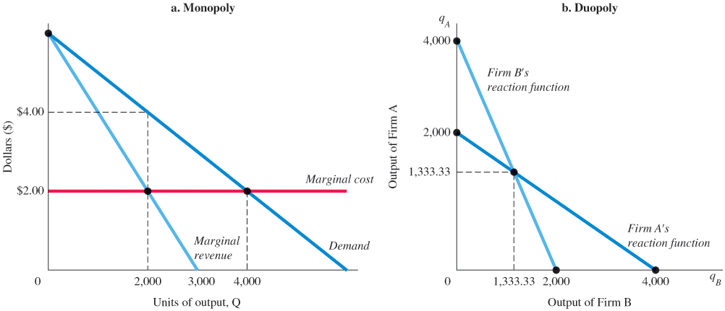
Figure 14.2 Graphical Depiction of the Cournot Model
Panel (a) shows a profit-maximizing output of 2,000 units for a monopolist with marginal cost of $2.00.
Panel (b) shows output of 1,333.33 units each for two duopolists with the same marginal cost of $2.00, facing the same demand curve.
Total industry output increases as we go from the monopolist to the Cournot duopolists, but it does not rise as high as the competitive output (here 4,000 units).

Slide 14

Economics In Practice (3 of 5)
Ideology and Newspapers
Economists find a strong relationship between the way a town votes and the political affiliation of its newspapers.
A 10% increase in a town’s Republican vote share increases the demand for a Republican newspaper by 10%.
Newspapers also try to differentiate themselves: One Republican newspaper existing in an area decreases the likelihood of another Republican newspaper by 15%.
CRITICAL THINKING
How would you expect the possibility of differentiating your product to change competition between oligopolists?

Slide 15
Game Theory (1 of 2)
game theory Analyzes the choices made by rival firms, people, and even governments when they are trying to maximize their own well-being while anticipating and reacting to the actions of others in their environment.
dominant strategy In game theory, a strategy that is best no matter what the opposition does.

Slide 16
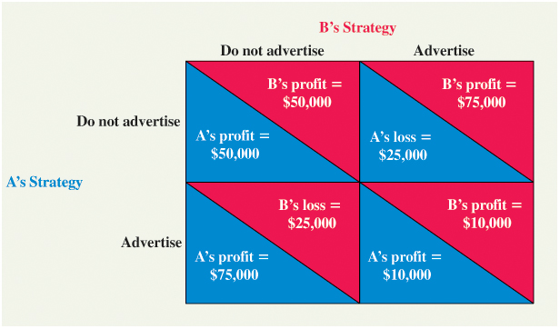
Figure 14.3 Payoff Matrix for Advertising Game
Both players have a dominant strategy.
If B does not advertise, A will advertise because $75,000 beats $50,000.
If B does advertise, A will also advertise because a profit of $10,000 beats a loss of $25,000. A will advertise regardless of what B does. Similarly, B will advertise regardless of what A does.
If A does not advertise, B will advertise because $75,000 beats $50,000.
If A does advertise, B will too because a $10,000 profit beats a loss of $25,000.

Slide 17
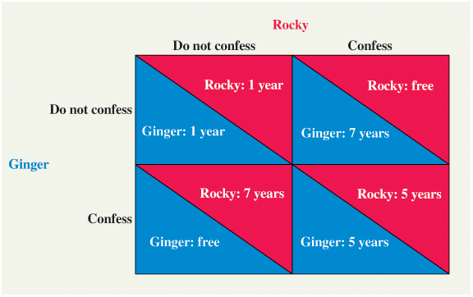
Figure 14.4 The Prisoners’ Dilemma
Both players have a dominant strategy and will confess.
If Rocky does not confess, Ginger will because going free beats a year in jail.
Similarly, if Rocky does confess, Ginger will confess because 5 years in the slammer is better than 7.
Rocky has the same set of choices. If Ginger does not confess, Rocky will because going free beats a year in jail.
Similarly, if Ginger does confess, Rocky also will confess because 5 years in the slammer is better than 7. Each will confess regardless of what the other does.

Slide 18
Game Theory (2 of 2)
prisoners’ dilemma A game in which the players are prevented from cooperating and in which each has a dominant strategy that leaves them both worse off than if they could cooperate.
Nash equilibrium In game theory, the result of all players’ playing their best strategy, given what their competitors are doing.
maximin strategy In game theory, a strategy chosen to maximize the minimum gain that can be earned.

Slide 19
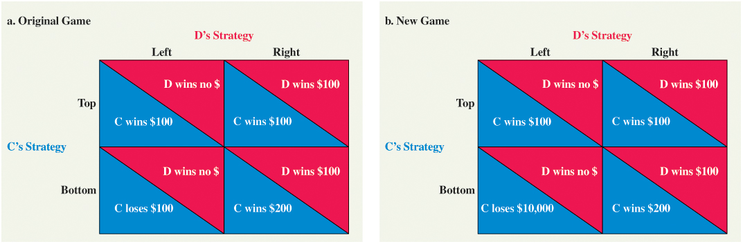
Figure 14.5 Payoff Matrixes for Left/Right–Top/Bottom Strategies
In the original game (a), C does not have a dominant strategy. If D plays left, C plays top; if D plays right, C plays bottom. D, on the other hand, does have a dominant strategy: D will play right regardless of what C does. If C believes that D is rational, C will predict that D will play right. If C concludes that D will play right, C will play bottom. The result is a Nash equilibrium because each player is doing the best that it can given what the other is doing.
In the new game (b), C had better be very sure that D will play right because if D plays left and C plays bottom, C is in big trouble, losing $10,000. C will probably play top to minimize the potential loss if the probability of D’s choosing left is at all significant.

Slide 20
Repeated Games
tit-for-tat strategy A repeated game strategy in which a player responds in kind to an opponent’s play.

Slide 21

Figure 14.6 Payoff Matrix for Airline Game
In a single play, both British Airways (BA) and Lufthansa Airlines (LA) have dominant strategies. If LA prices at $600, BA will price at $400 because $1.6 million beats $1.2 million.
If, on the other hand, LA prices at $400, BA will again choose to price at $400 because $800,000 beats zero. Similarly, LA will choose to price at $400 regardless of which strategy BA chooses.

Slide 22
Economics In Practice (4 of 5)
Confusing Prices
Even in the grocery stores, price labels are not always so easy to understand: Price per unit, price per weight, price with tax included, and discounted prices using percentages versus dollars.
Economists found that complexity in different price frames “softens” competition.
CRITICAL THINKING
You are shopping for a new microwave. How would reducing price transparency soften competition between sellers of microwaves?

Slide 23
A Game with Many Players: Collective Action Can Be Blocked by a Prisoner’s Dilemma
Coordinated collective action in everybody’s interest can be blocked under some circumstances.
A multiple-player game can result in a classic prisoners’ dilemma, where collusion if it could be enforced would result in an optimal outcome but where dominant strategies result in a suboptimal outcome.
To break this dilemma, we pass laws that allow government to become a player.
The only necessary condition of oligopoly is that firms are large enough to have some control over price.

Slide 24
Oligopoly and Economic Performance
Except with the contestable-markets model, concentration in a market leads to pricing above marginal cost and output below the efficient level.
However, vigorous product competition among oligopolistic competitors may produce variety and lead to innovation.

Slide 25
Industrial Concentration and Technological Change
One of the major sources of economic growth and progress throughout history has been technological advance.
Several economists, notably Joseph Schumpeter and John Kenneth Galbraith, argued that industrial concentration actually increases the rate of technological advance.

Slide 26
The Role of Government
Regulation of Mergers
Celler-Kefauver Act Extended the government’s authority to control mergers.
Herfindahl-Hirschman Index (HHI) An index of market concentration found by summing the square of percentage shares of firms in the market.

Slide 27
Table 14.2 Calculation of a Simple Herfindahl-Hirschman Index for Four Hypothetical Industries, Each with No More Than Four Firms
Percentage Share of:
 | Firm 1 | Firm 2 | Firm 3 | Firm 4 | Herfindahl-Hirschman Index
Industry A | 50 | 50 | — | — | 50² + 50² = 5,000
Industry B | 80 | 10 | 10 | — | 80² + 10² + 10² = 6,600
Industry C | 25 | 25 | 25 | 25 | 25² + 25² + 25² + 25² = 2,500
Industry D | 40 | 20 | 20 | 20 | 40² + 20² + 20² + 20² = 2,800

Slide 28
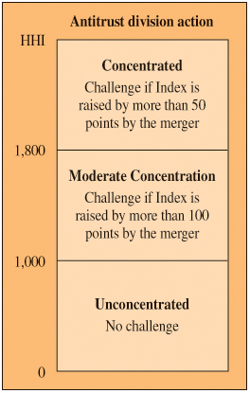
Figure 14.7 Department of Justice Merger Guidelines (Revised 1984)

Slide 29
Table 14.3
Industry Definition | Some Sample HHIs
Beer | 3,525
Ethanol | 326
Las Vegas gaming | 1,497
Critical care patient monitors | 2,661

Slide 30
Regulation of Mergers
In 1997, the Department of Justice and the FTC issued joint Horizontal Merger Guidelines.
The government now examines each potential merger to determine whether it enhances the firms’ power to engage in “coordinated interaction” with other firms in the industry.
“Coordinated interaction” is defined as “actions by a group of firms that are profitable for each of them only as the result of the accommodating reactions of others. This behavior includes tacit or express collusion and may or may not be lawful in and of itself.”

Slide 31
Economics In Practice (5 of 5)
Block That Movie Advertisement!
Almost 90% of advertisements in movie theaters are produced by two firms: National CineMedia, Inc., and Screenvision.
In 2014, National made an offer to buy Screenvision. The U.S. Department of Justice brought suit to block the merger, charging that it would reduce price competition.
National argued that the merged firms could benefit movie theaters with broader product variety.
CRITICAL THINKING
Why do you think there are so few firms in this business in the first place?

Slide 32
A Proper Role for Government?
One view concerning the role of government in regulating markets is that high levels of concentration lead to inefficiency and that government should act to improve the situation.
An opposing view holds that the clearest examples of effective barriers to entry are those created by government.
Further complicating the debate, firms that dominate a domestic market may be fierce competitors in the international arena.

Slide 33
Review Terms and Concepts
cartel
Celler-Kefauver Act
concentration ratio
contestable markets
dominant strategy
duopoly
Five Forces model
game theory
Herfindahl-Hirschman Index (HHI)
maximin strategy
Nash equilibrium
oligopoly
price leadership
prisoners’ dilemma
tacit collusion
tit-for-tat strategy

Slide 34
Copyright
This work is protected by United States copyright laws and is provided solely for the use of instructors in teaching their courses and assessing student learning. Dissemination or sale of any part of this work (including on the World Wide Web) will destroy the integrity of the work and is not permitted. The work and materials from it should never be made available to students except by instructors using the accompanying text in their classes. All recipients of this work are expected to abide by these restrictions and to honor the intended pedagogical purposes and the needs of other instructors who rely on these materials.

